Slide 1



Implementation of NLP Chatbot
Student name -: MOHAMMED SHOAIB
AICTE Student ID-STU6743d91bd7a671732499739

Slide 2

Learning Objectives
Develop a chatbot using Natural Language Processing (NLP).
Train the chatbot using intents and responses stored in JSON.
Implement the chatbot using Python, NLTK, and Scikit-learn.
Deploy the chatbot using Streamlit for an interactive UI.
GOAL
Source :
www.freepik.com/

Slide 3
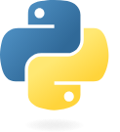
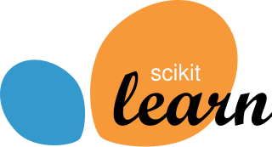

Tools and Technology used
Programming Language: Python
Libraries: NLTK, Scikit-learn, Streamlit, JSON, TfidfVectorizer, Logistic Regression
Data Processing: Tokenization, Text Vectorization (TF-IDF)

Slide 4
Methodology
Convert text to numerical representation using TF-IDF vectorization.
Train a Logistic Regression Model for intent classification.
Load and preprocess data from intents.json ( User queries and responses ).
Create a Streamlit UI to take user input and display chatbot responses.
Store conversation history in a CSV file.

Slide 5
Problem Statement
In today's fast-paced digital world, users expect instant and accurate responses to their queries. Traditional customer support systems often face challenges such as :
1. Long wait times for responses.
2. Limited availability (e.g., working hours).
3. High operational costs for human agents.
To address these issues, Natural Language Processing (NLP)-based chatbot provide an automated, intelligent, and efficient way to interact with users. This project aims to develop an NLP-powered chatbot that can understand user queries, classify intents, and generate relevant responses, improving user experience and efficiency.

Slide 6
Solution
Utilize Machine Learning to classify user input into predefined intents.
Generate dynamic responses based on classified intents.
Implement a user-friendly chatbot UI with Streamlit.
Maintain chat history for better user experience.
GITHUB REPOSITORY :
https://github.com/noddy1313/pybot.git

Slide 7
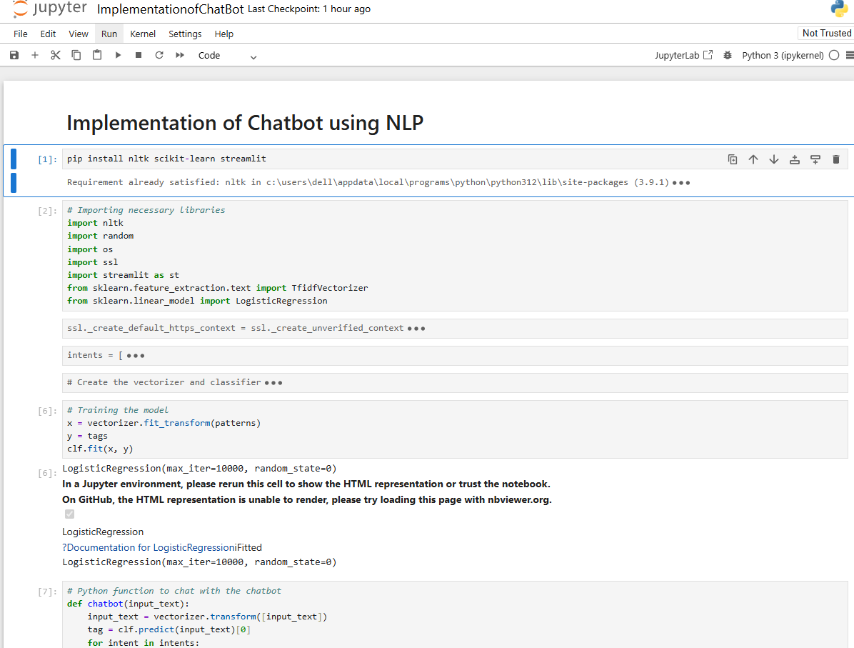
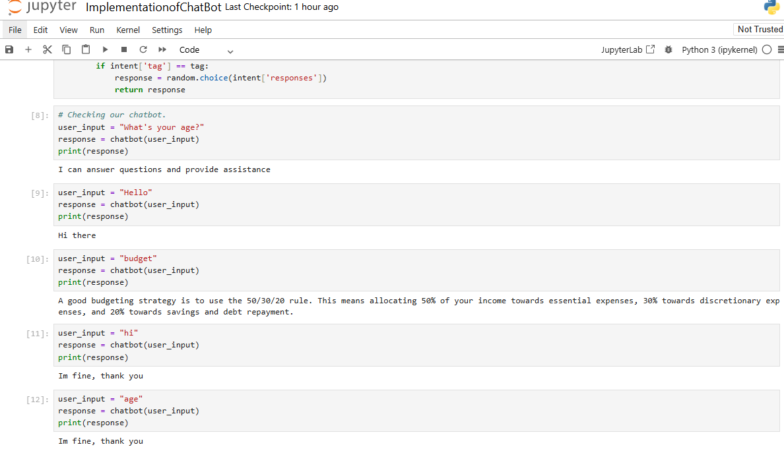
Screenshot of Output
Fig -: CODE IMPLEMENTATION

Slide 8
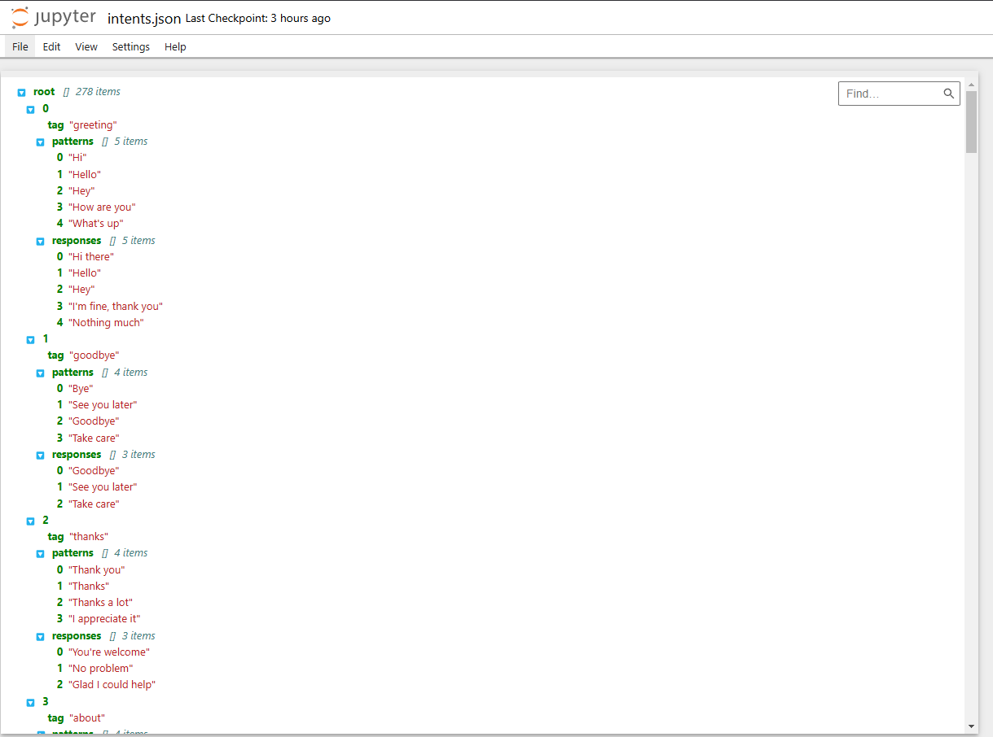
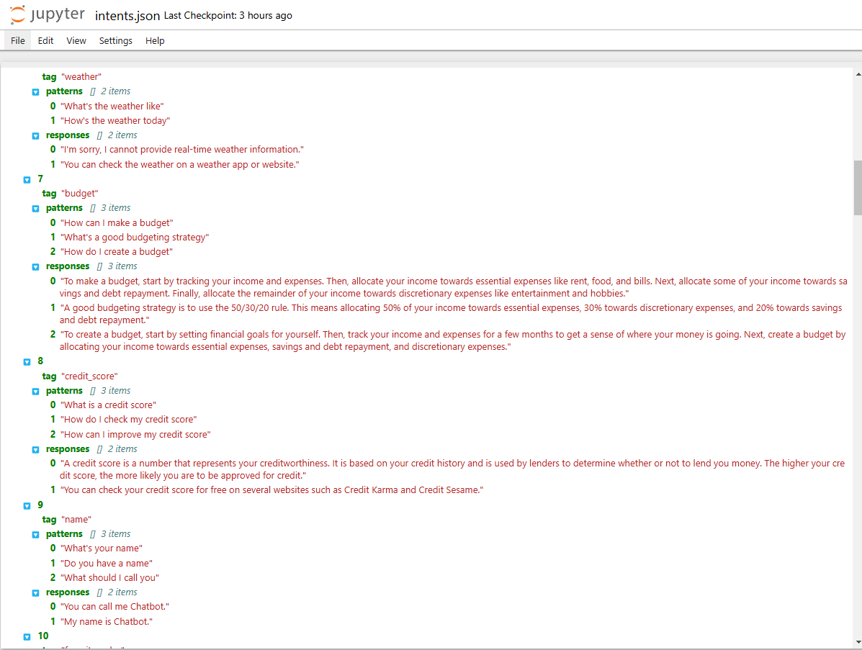
Fig -: SOME INTENTS INSIDES

Slide 9
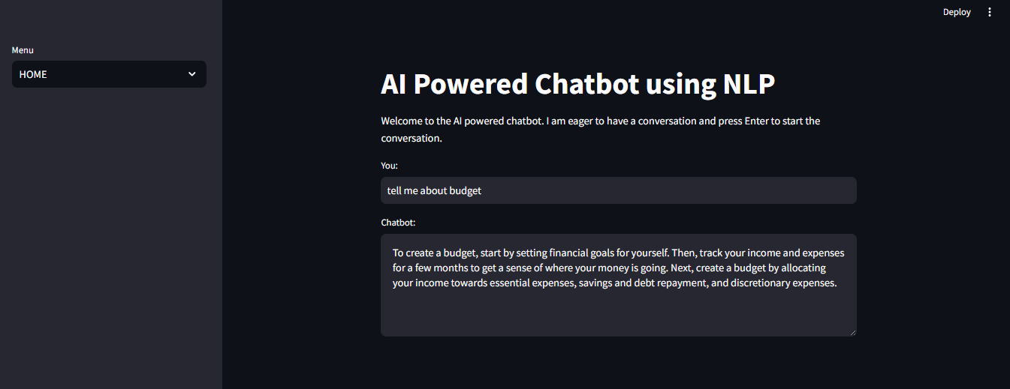
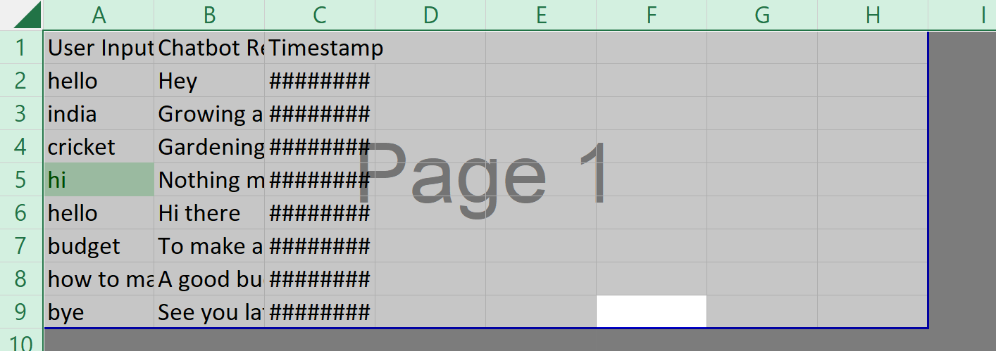
Fig -: Real-Time Chatbot Responses
Fig -: User Querie & Chatbot Responses Log

Slide 10
Conclusion
1. NLP-powered chatbot are transforming the way we interact with
technology.
2. They provide instant responses, improve user engagement, and automate tasks efficiently.
3. This chatbot, built using NLTK, Scikit-learn and Streamlit demonstrates text classification and response generation.
4. Future improvements could include deep learning models, better intent recognition, and API integration for real-time data.
5. Chatbot will continue evolving, making interactions smarter, faster, and more human-like.

